Slide 2
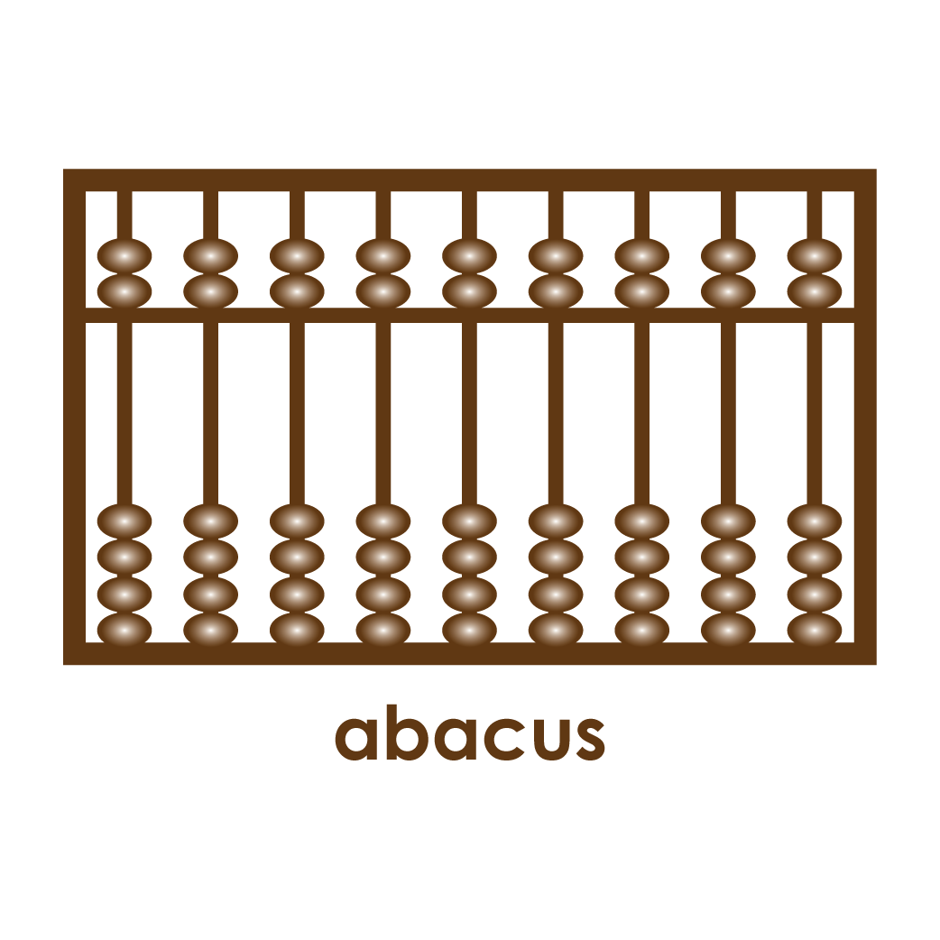

Slide 4
Notes:
Stop here to have students discuss answers before reviewing ID Images on the following slide.

Slide 5
ID Images are used to make sure the viewer understands unfamiliar vocabulary or situations. They essentially tell your viewer “here's what we're talking about.” ID images are important, but they should generally be small and be used only to identify the most important unknown concepts.

Slide 7
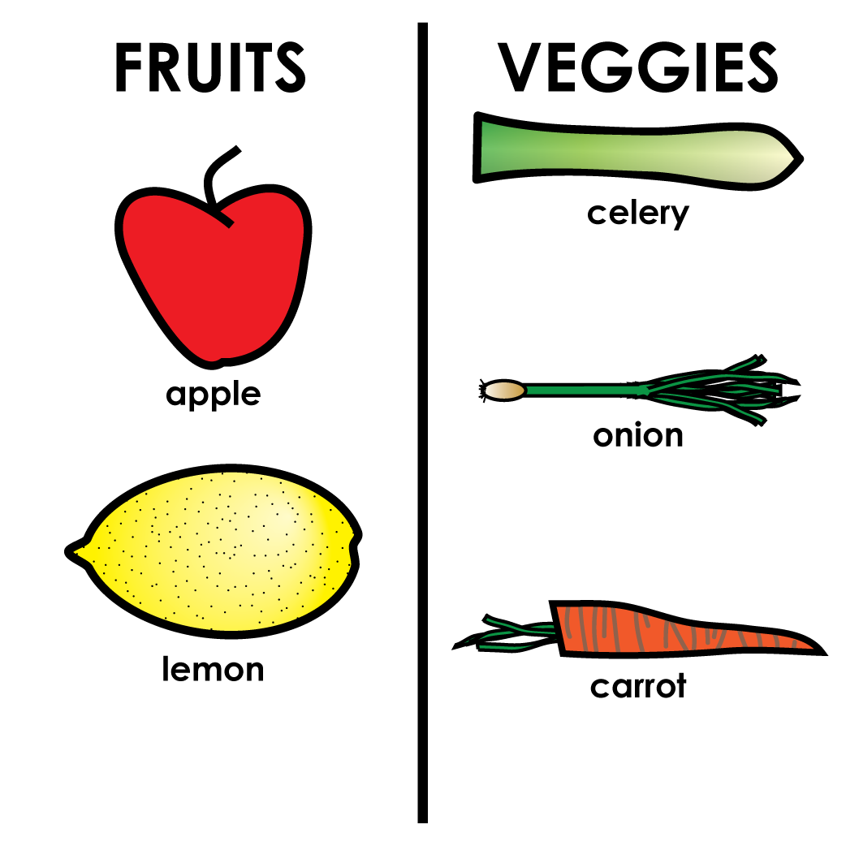

Slide 8
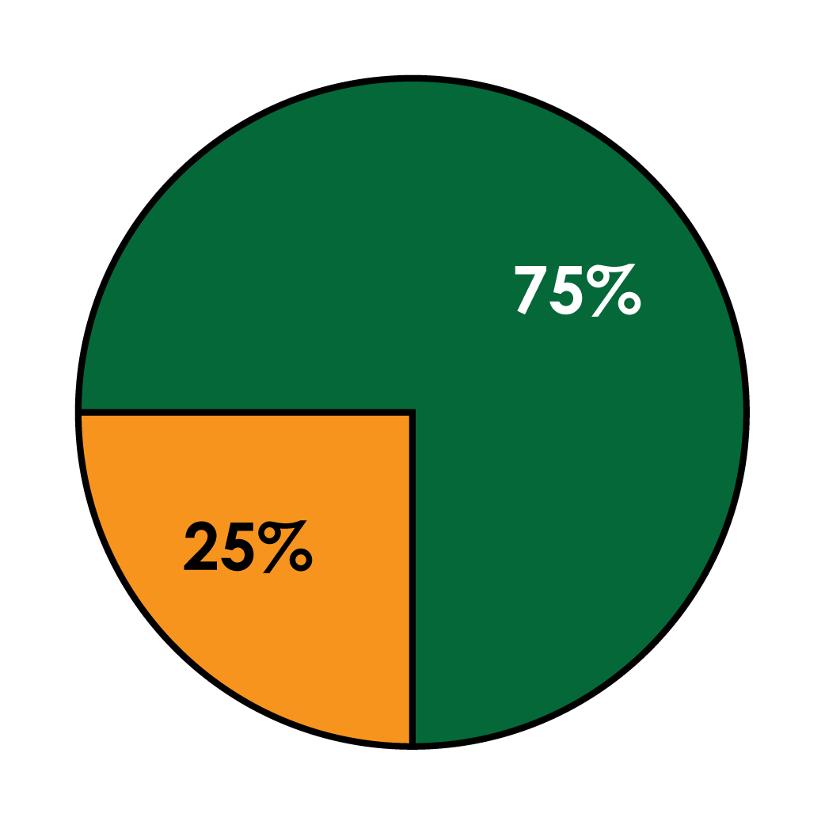

Slide 9
Notes:
Stop here to have students discuss answers before reviewing Comparative Images on the following slide.

Slide 10
Comparative Images can be used to sort or show the difference between numbers or words. Numbers might be organized in the form of a chart or graph (including line graphs, bar graphs, pie charts, and more) while words would more likely be sorted into categories. Comparative images are great but be careful how many you use. Comparative images generally require a large amount of the viewer's time in order to understand them.

Slide 14
Notes:
Stop here to have students discuss answers before reviewing Diagrammatic Images on the following slide.

Slide 15
Diagrams are used to explain processes, procedures, or the parts of a whole. Diagrams are typically used to show something complex, or something that would take many words to fully explain it. Like comparative images, diagrams require a fair amount of the viewer's time, but these images can usually explain much more than words alone would.

Slide 19
Notes:
Stop here to have students discuss answers before reviewing Decorative Images on the following slide.

Slide 20
Decorative Images are used merely to decorate – they look nice, but don't teach the viewer anything new. Decorative Images should be used rarely, though they can be useful as part of title banners.

