Slide 1
Poor Layout

Slide 2
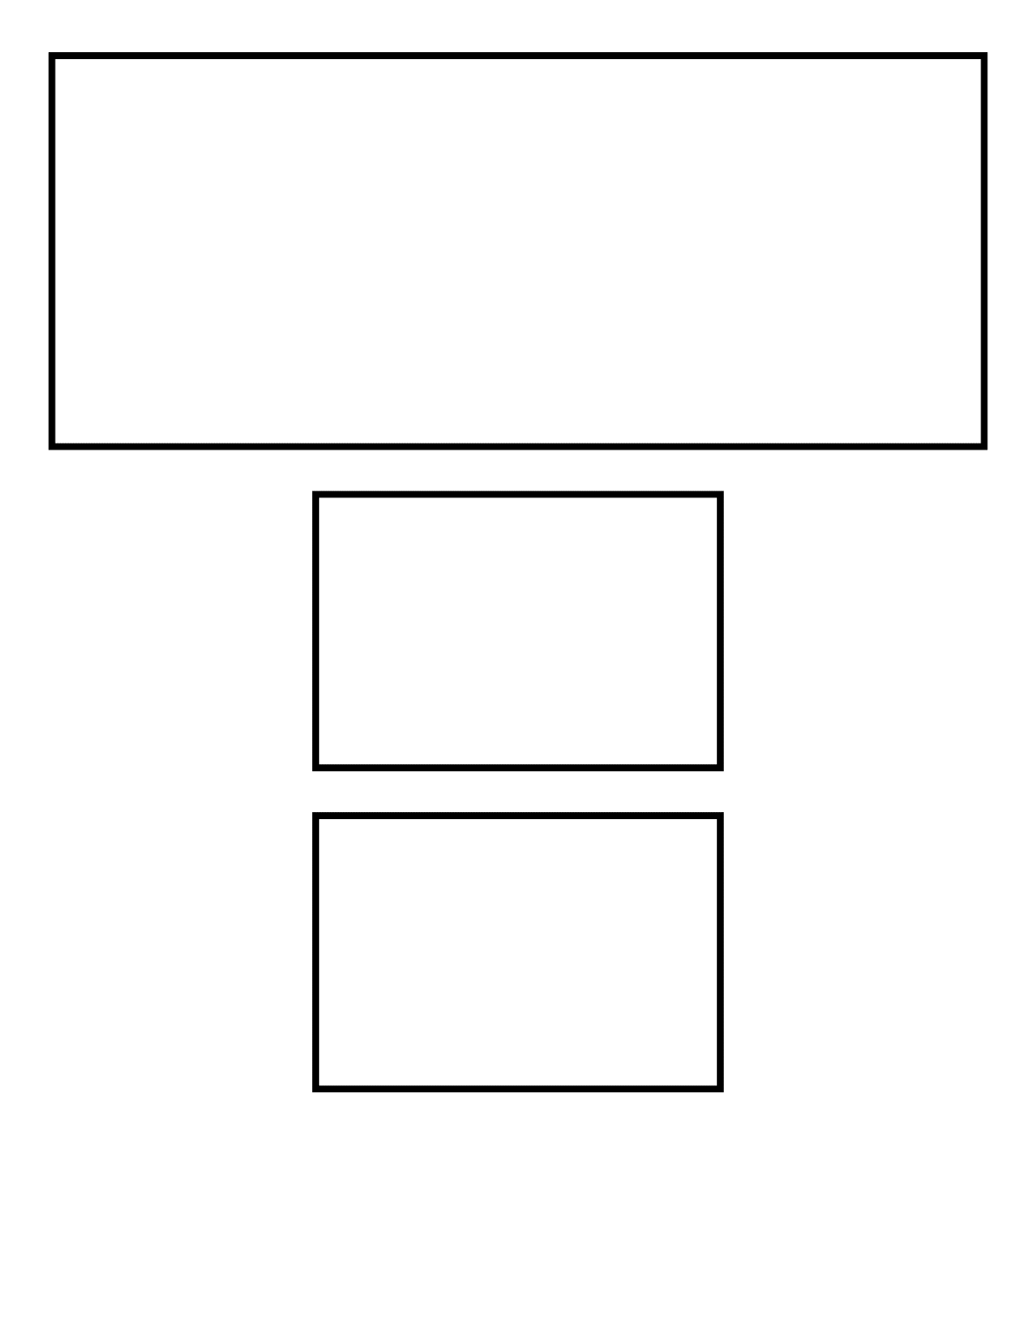
Better Layout

Slide 3
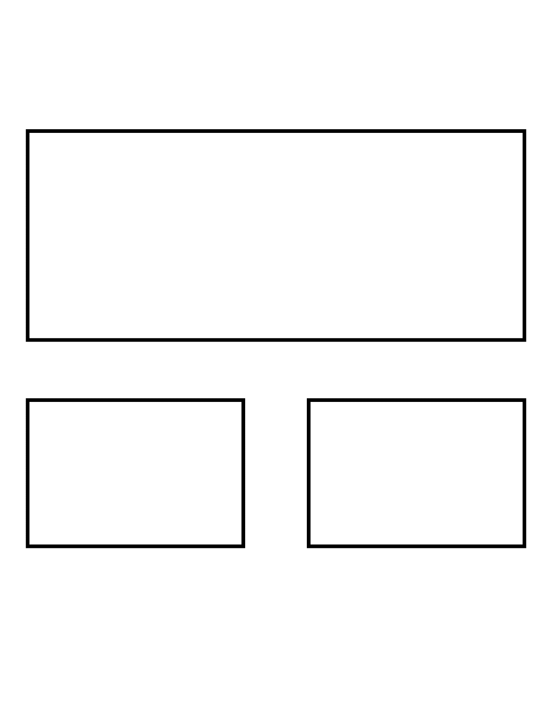
Best Layout

Slide 4
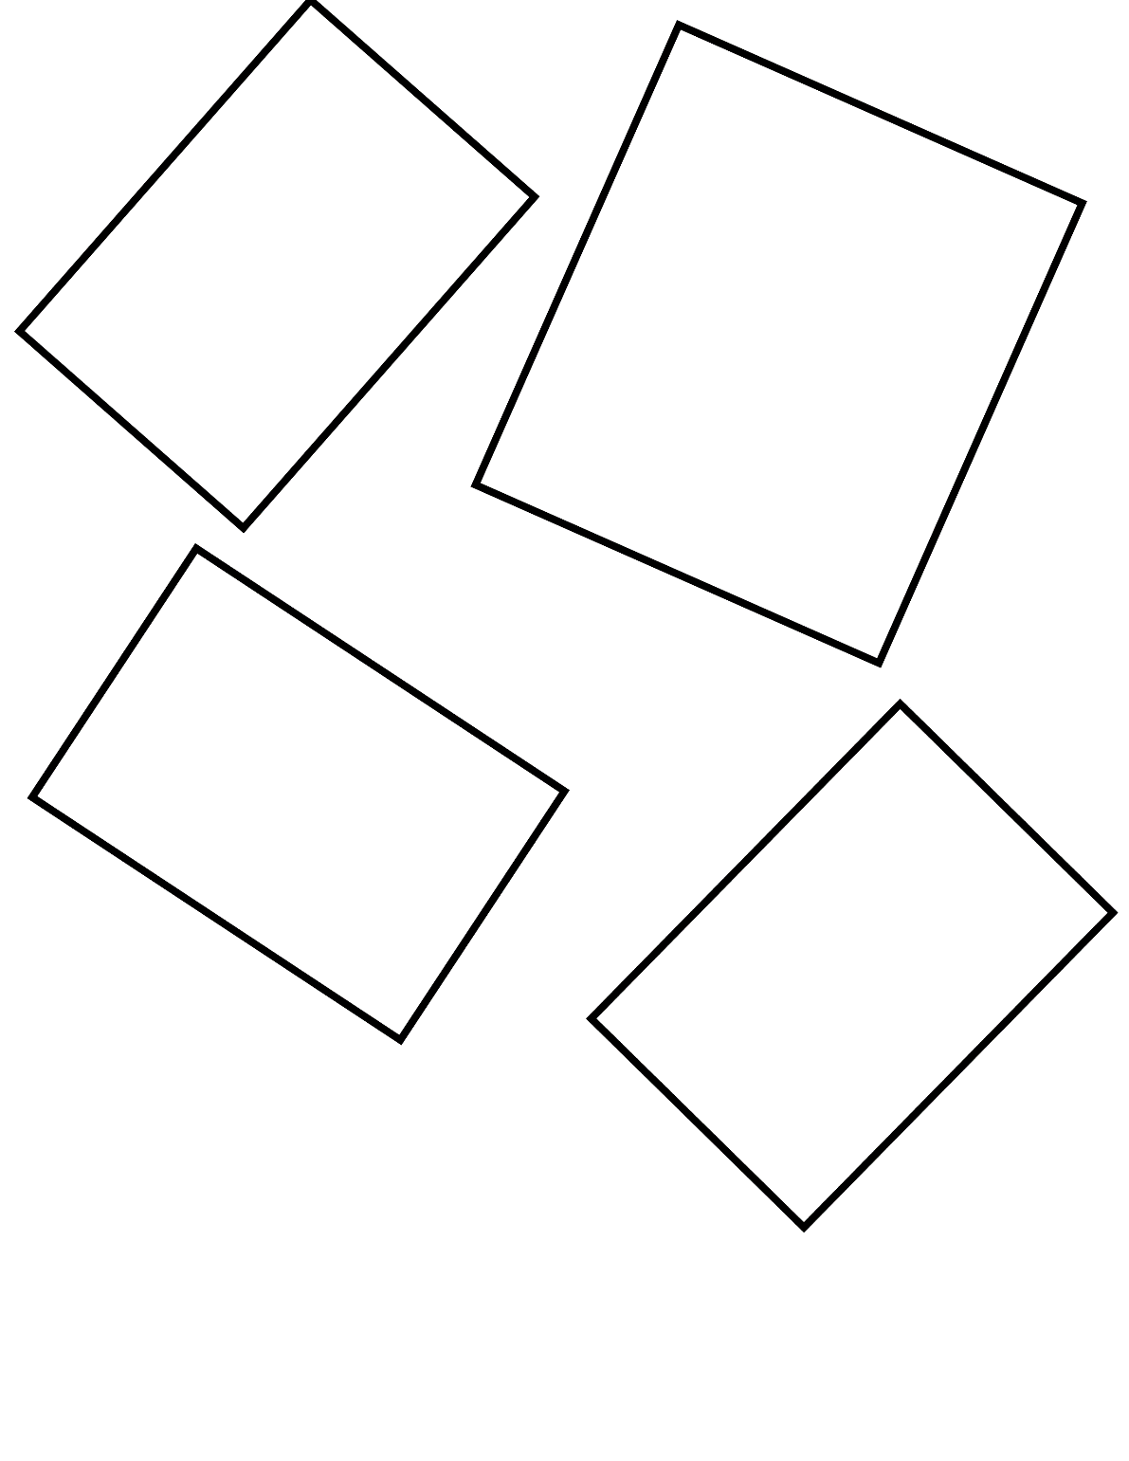
Poor Layout

Slide 5
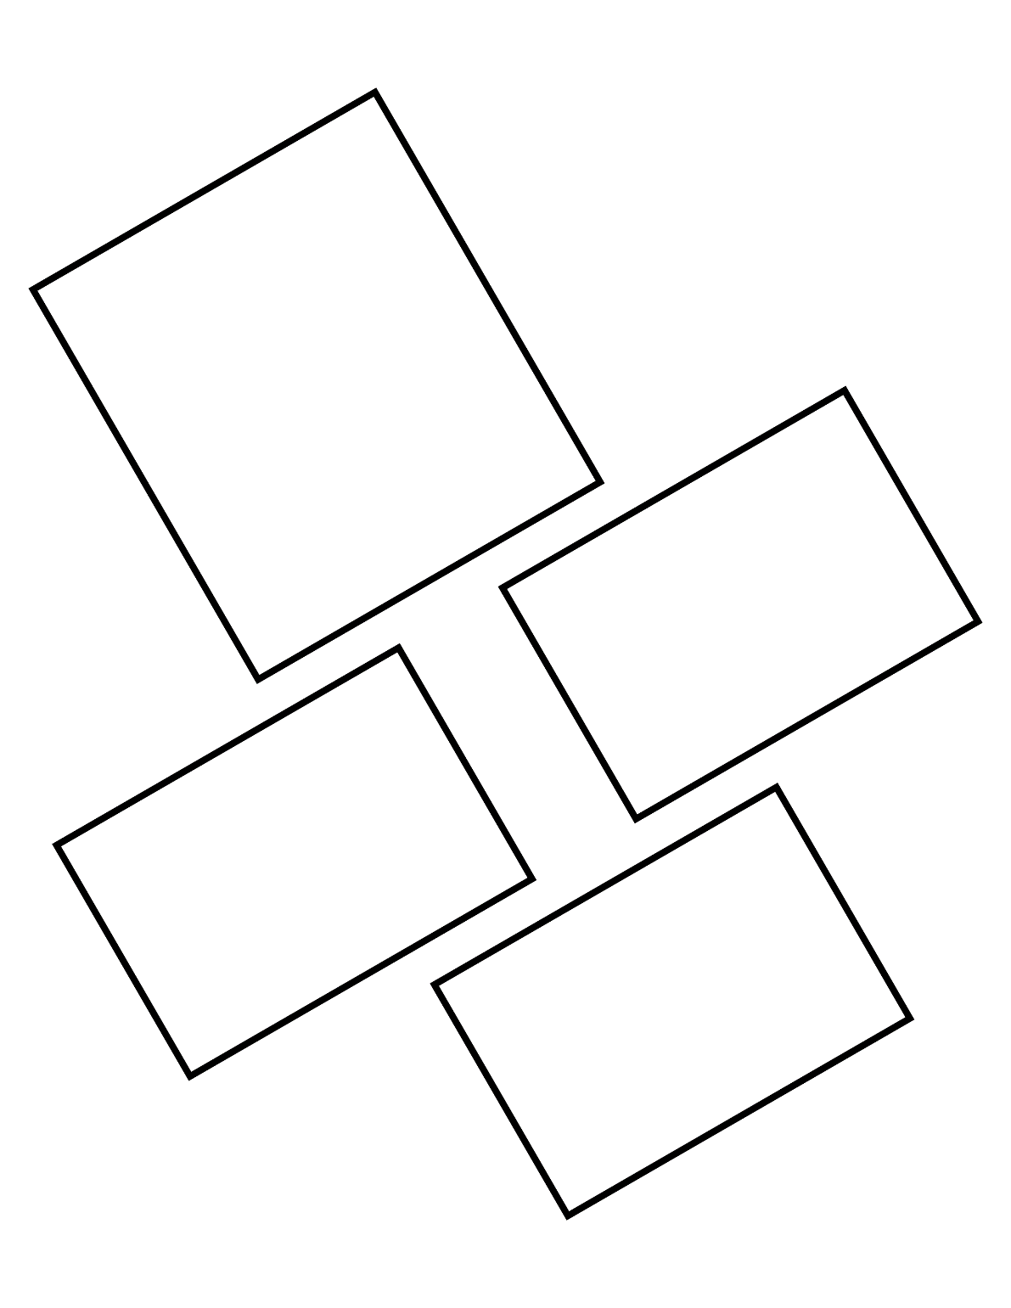
Better Layout

Slide 6
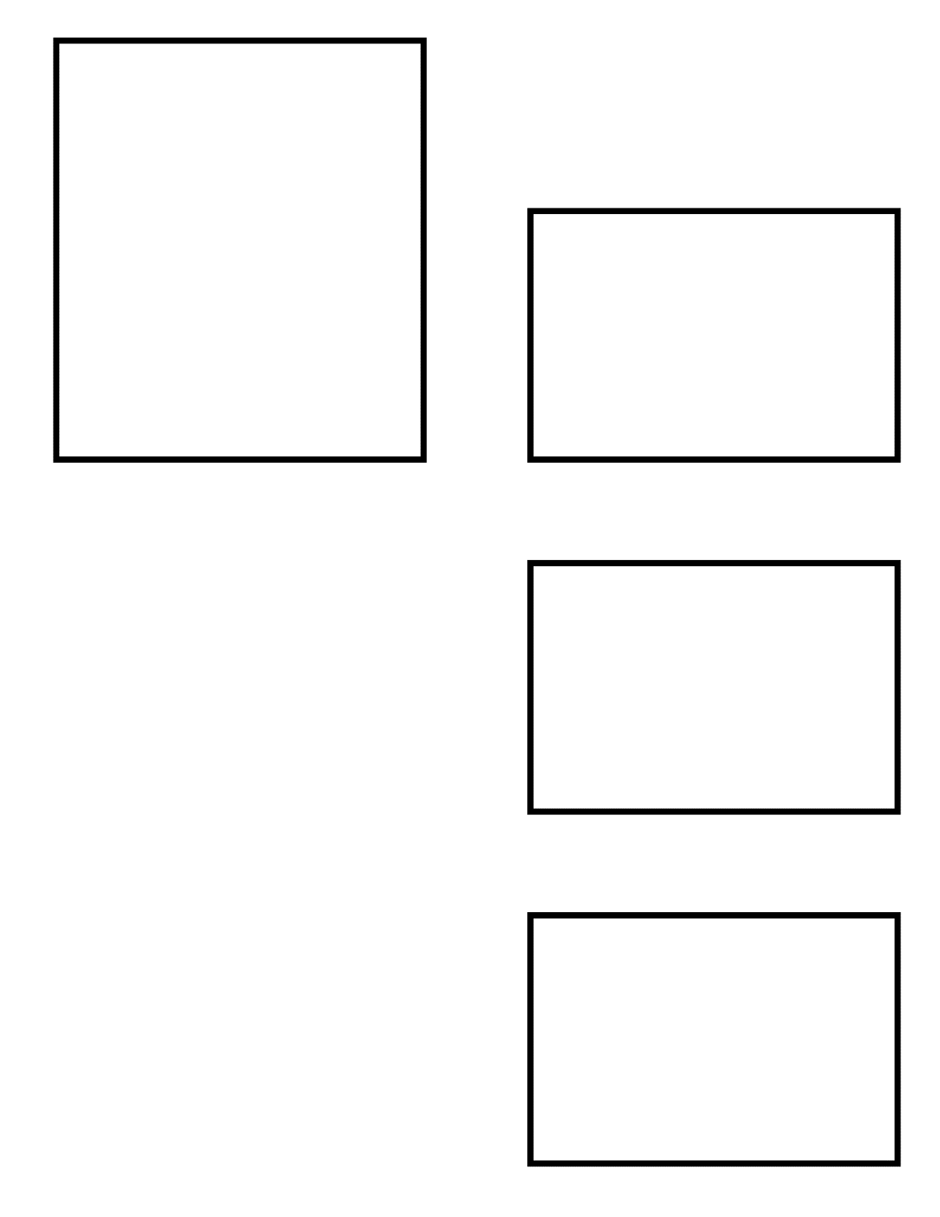
Better Layout

Slide 7
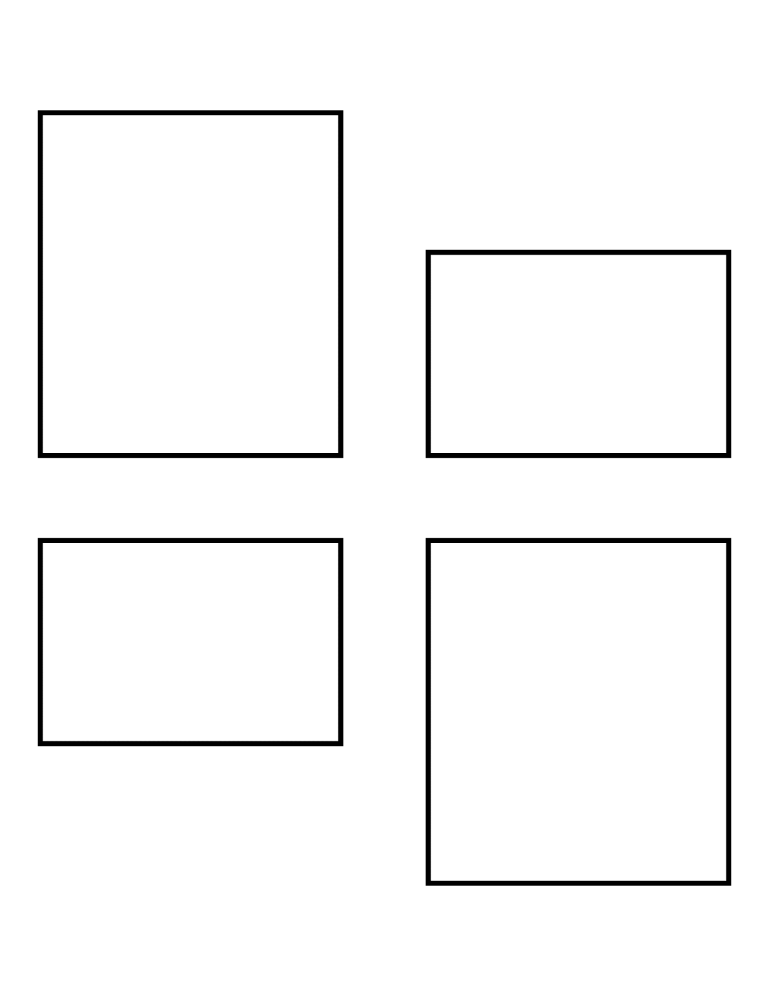
Best Layout

Slide 8
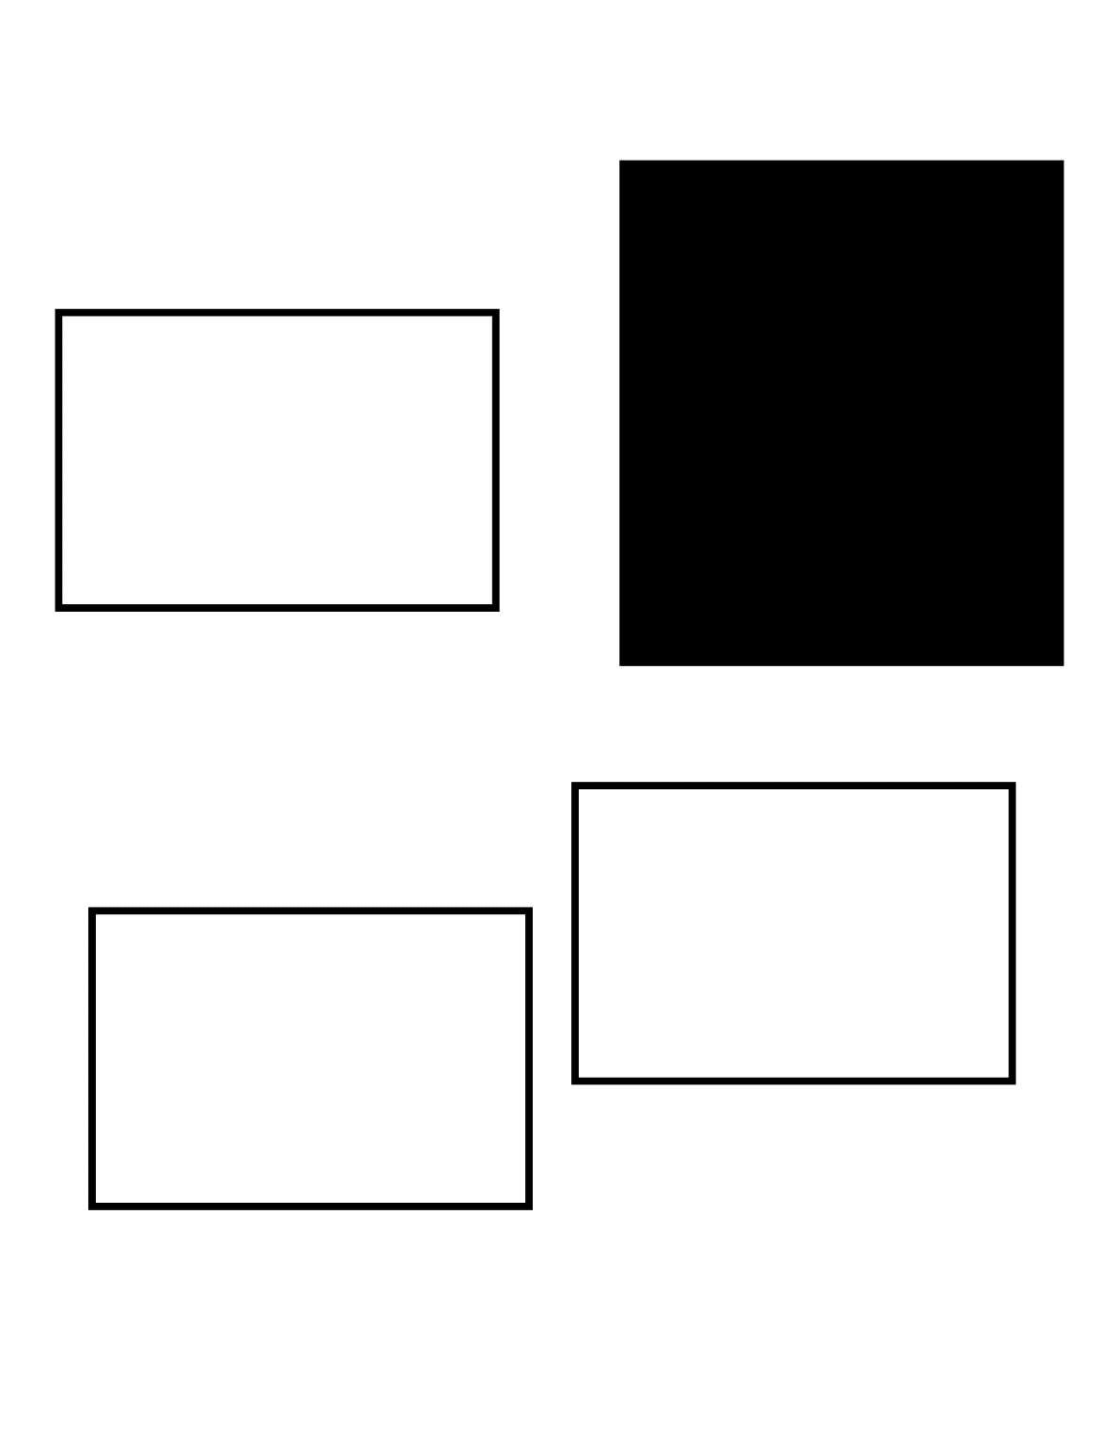
Poor Layout

Slide 9
Better Layout

Slide 10
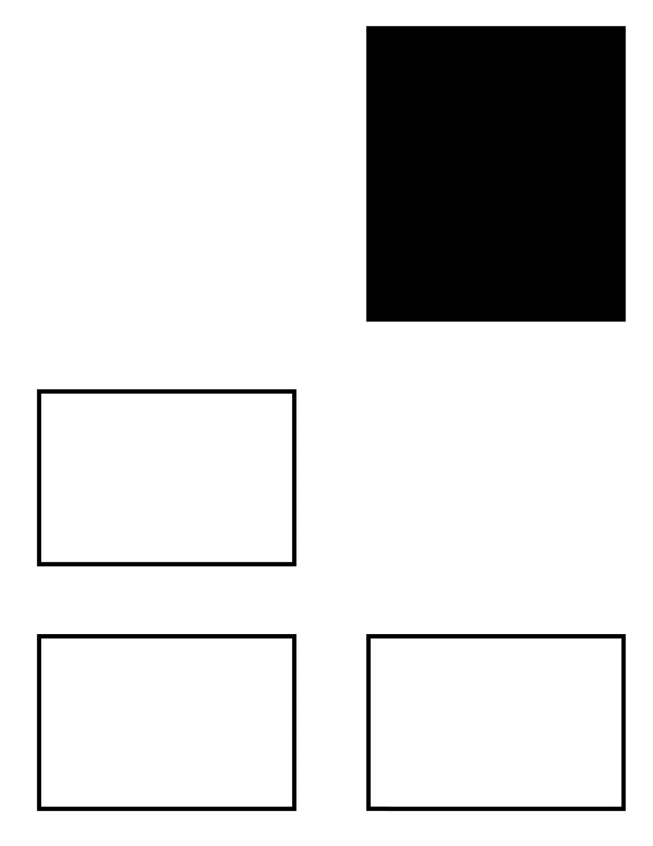
Better Layout

Slide 11
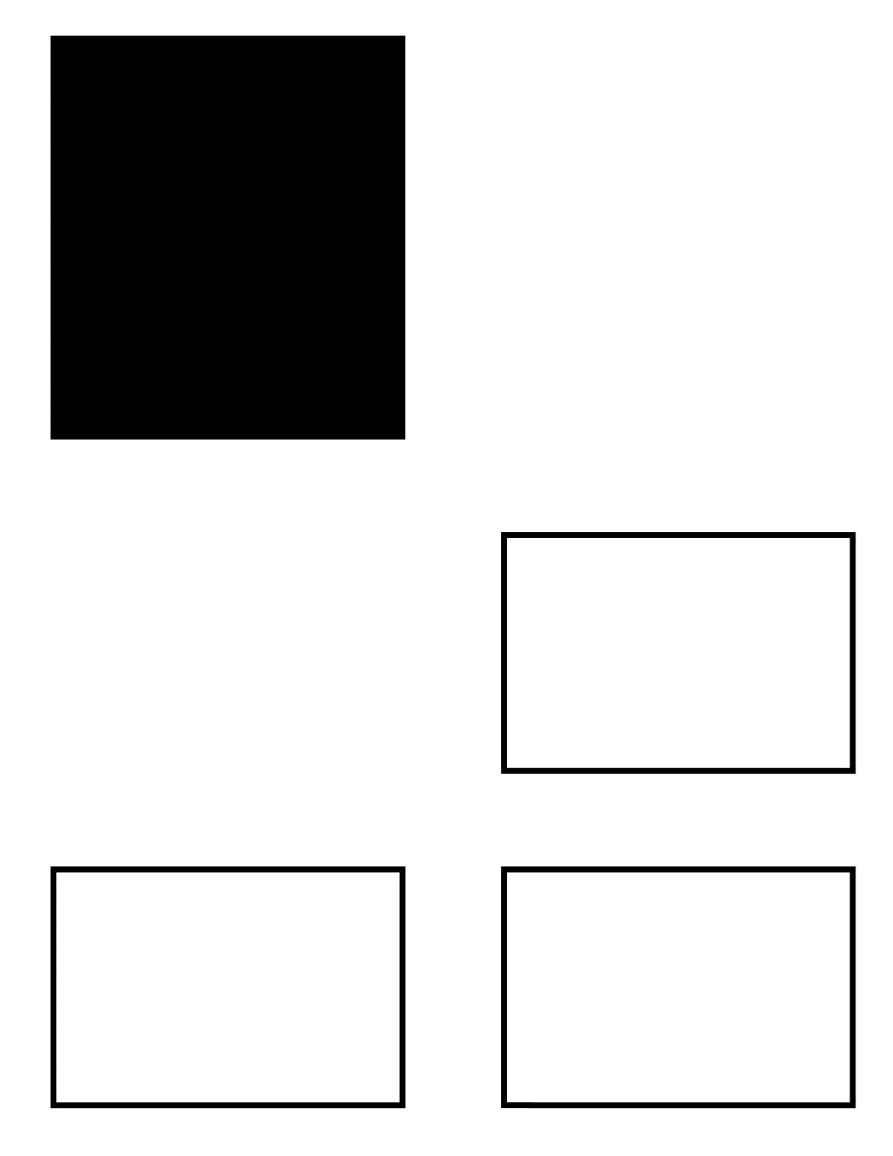
Best Layout

Slide 12
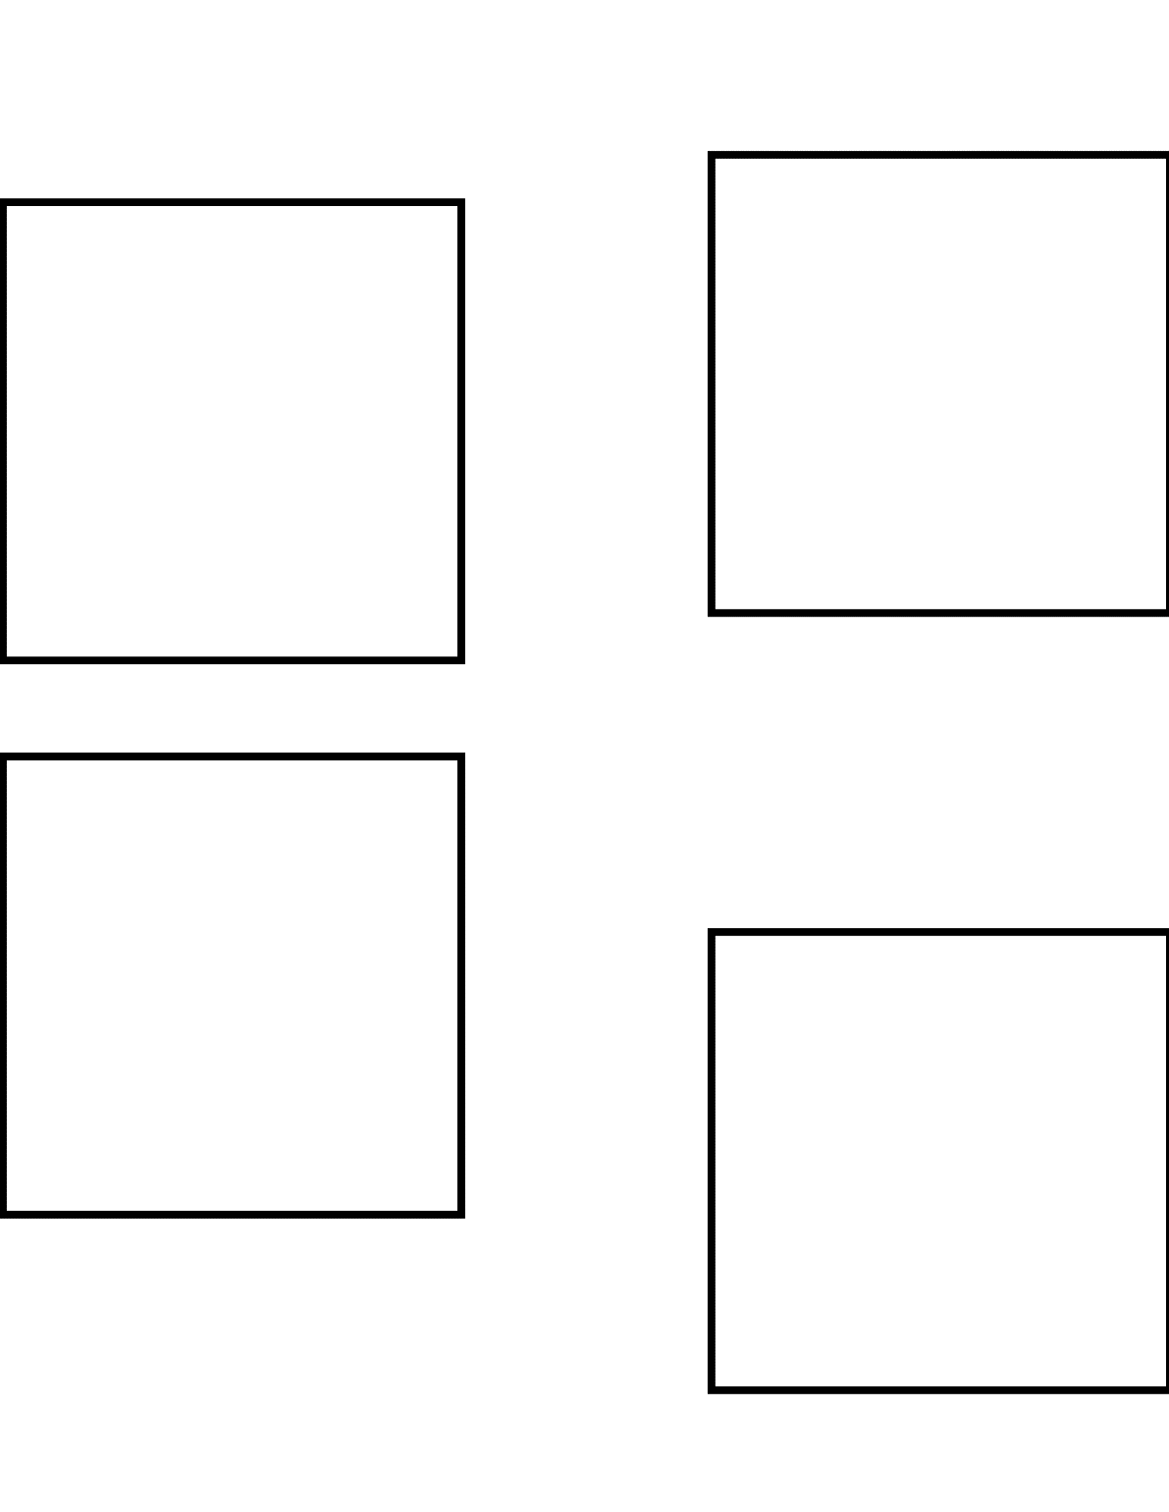
Poor Layout

Slide 13
Better Layout

Slide 14
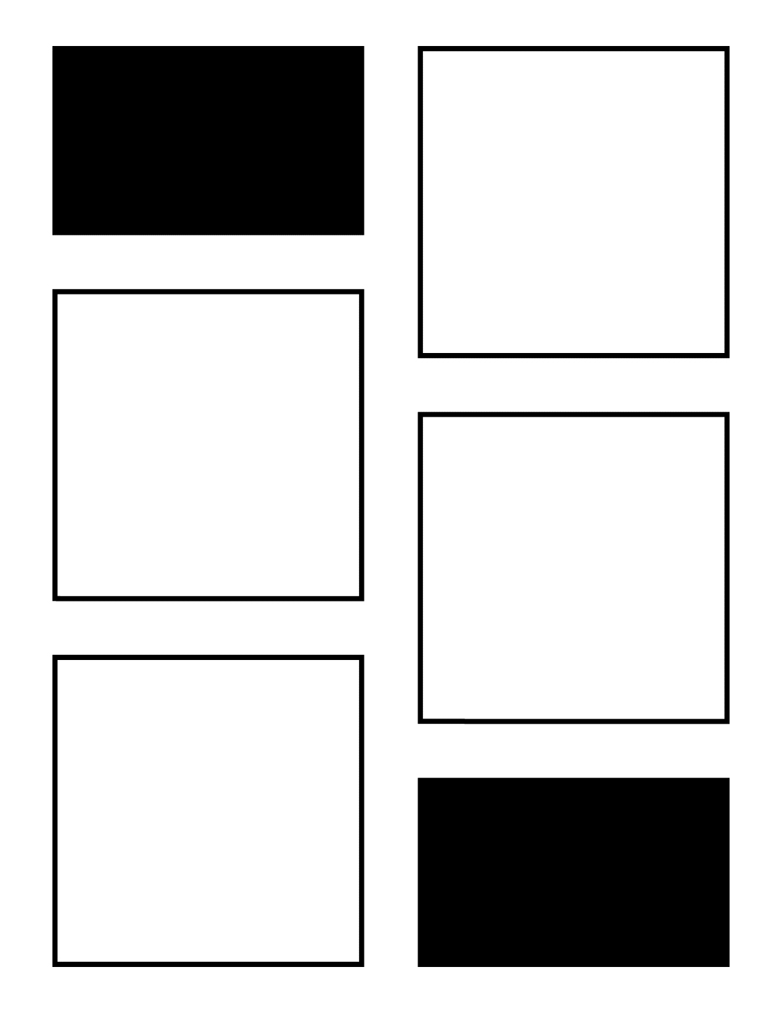
Best Layout

