Slide 1
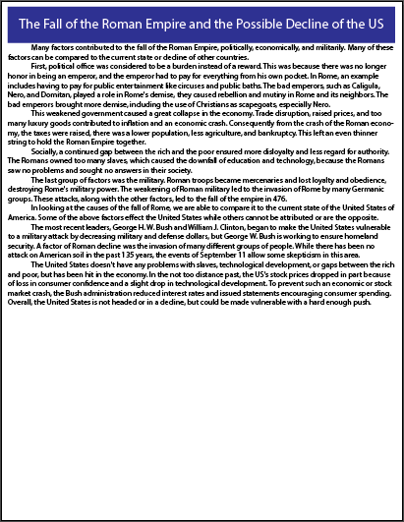
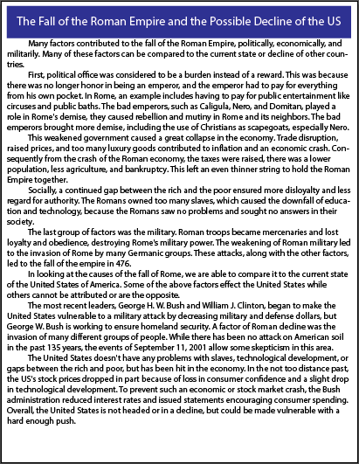
Choice A
Set 1
Choice B

Slide 2
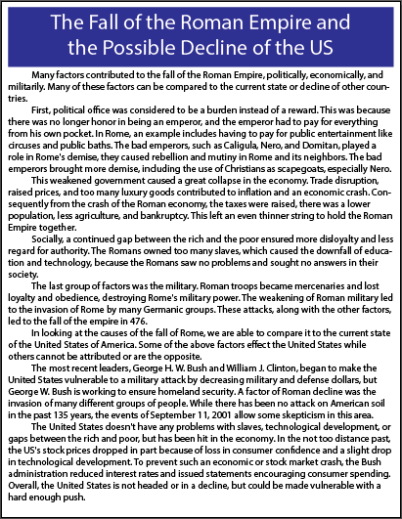
Choice A
Set 2
Choice B

Slide 3
Choice A
Set 3
Choice B

Slide 4
Choice A
Set 4
Choice B

Slide 5
Choice A
Set 5
Choice B

Slide 6
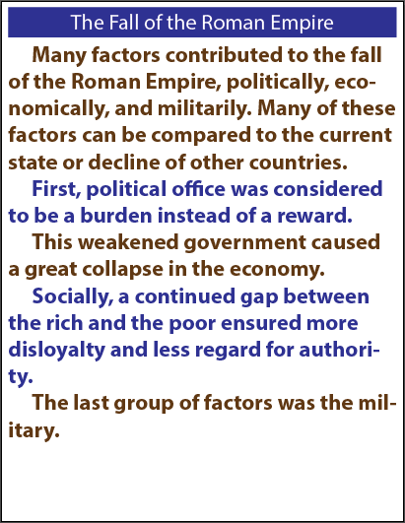
Choice A
Set 6
Choice B

Slide 7
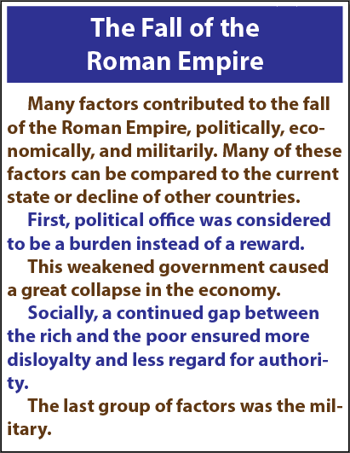
Choice A
Set 7
Choice B

Slide 8
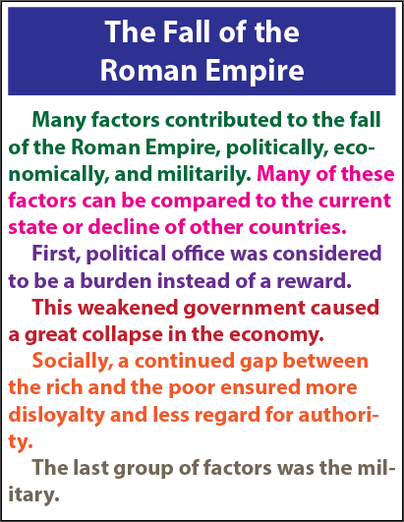
Choice A
Set 8
Choice B

Slide 9
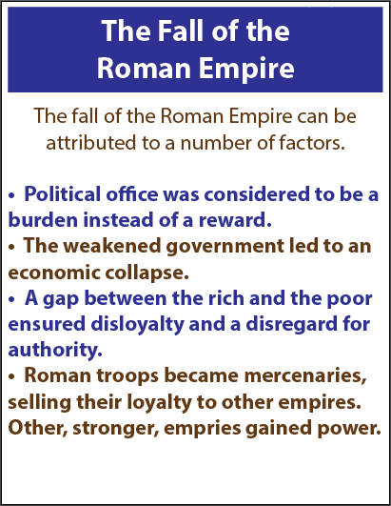
Choice A
Set 9
Choice B

Slide 10
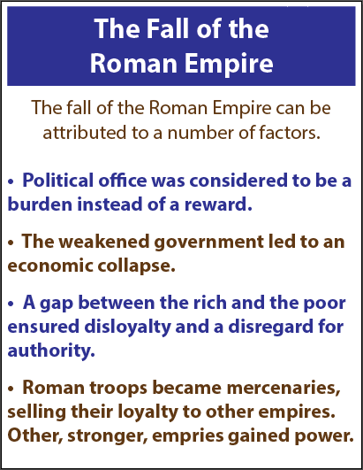
Choice A
Set 10
Choice B

Slide 11
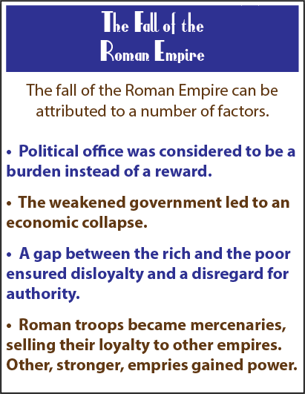
Choice A
Set 11
Choice B

Slide 12
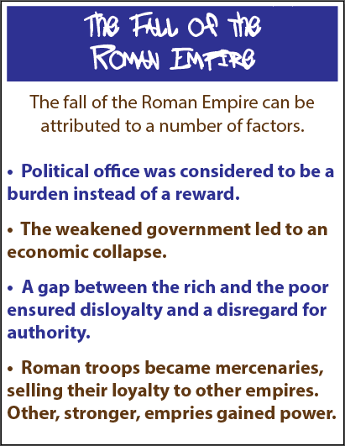
Choice A
Set 12
Choice B

Slide 13
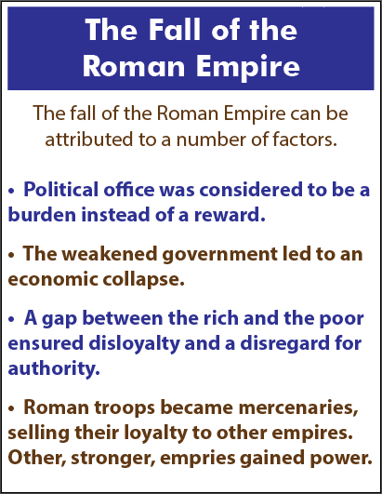
Choice A
Set 13
Choice B

Slide 14
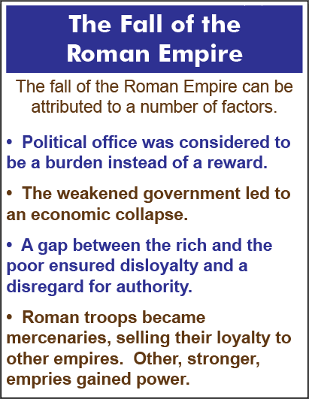
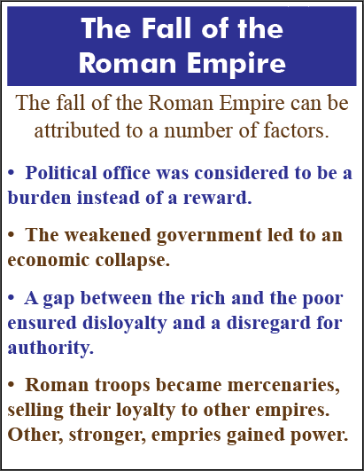
Choice A
Set 14
Choice B

Slide 15
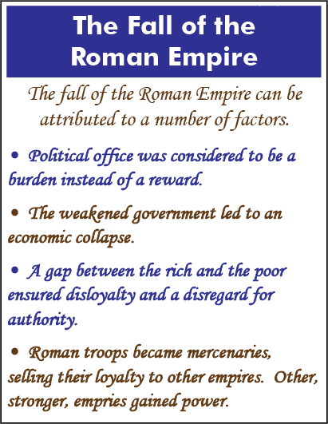
Choice A
Set 15
Choice B

Slide 16
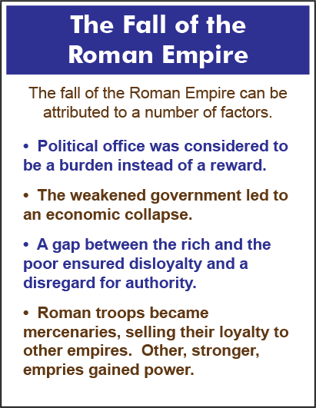
Choice A
Set 16
Choice B

Slide 17
Choice A
Set 17
Choice B

Slide 18
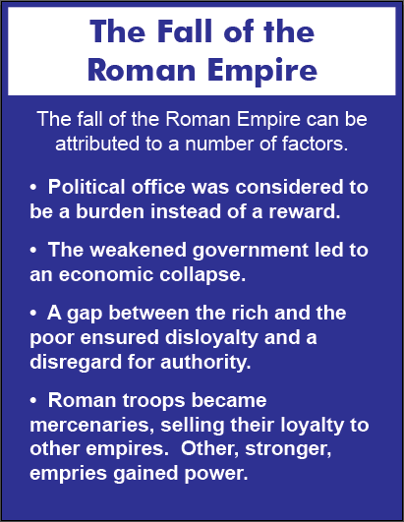
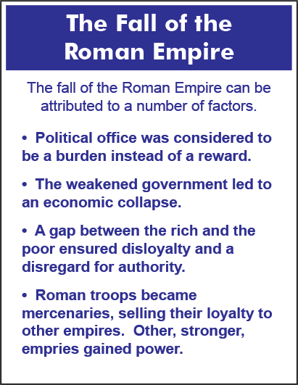
Choice A
Set 18
Choice B

